Slide 1
CLOTHES ‘R’ US
Debaleena Saha
Kunja Dutta
Prasraban Mukhopadhyay
Pratarshi Saha
Raghavendiran Nagarajan
Samarpita Chakrabarty
Date : 03-23-2017

Slide 2
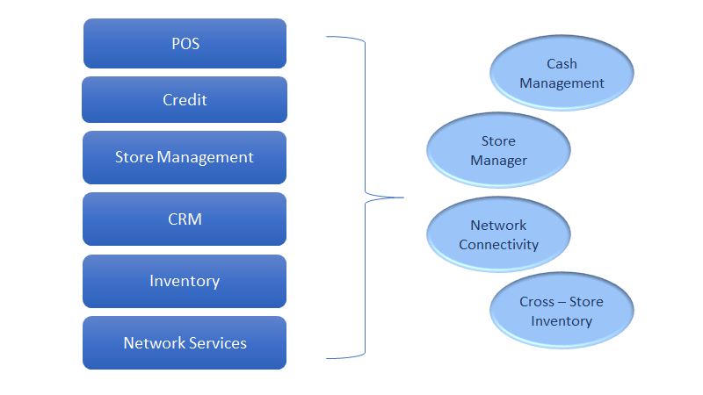
Introduction
SCOPE
Notes:
Samarpita

Slide 3
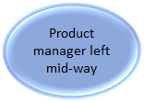
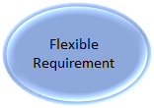
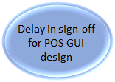
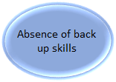

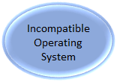
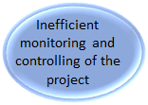
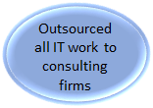
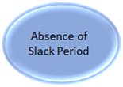
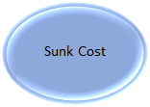
Issues
Notes:
Kunja

Slide 4
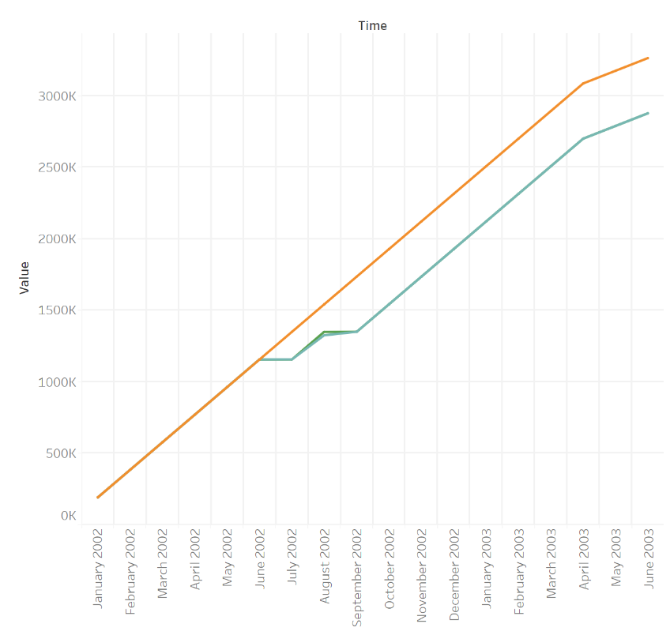

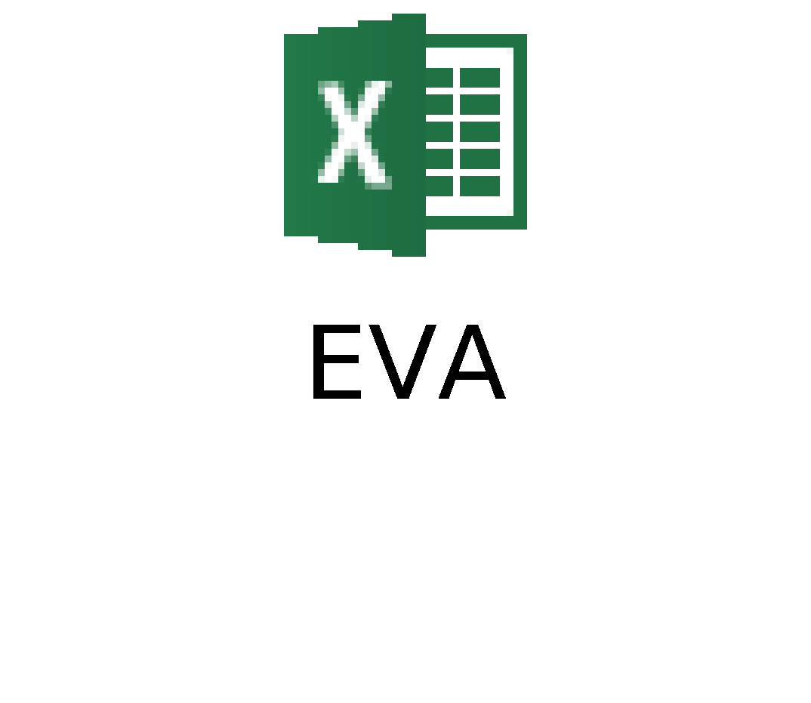
Analysis
https://public.tableau.com/views/EarnedValueAnalysisCharts/Monthly?:embed=y&:display_count=yes
Notes:
Pratarshi

Slide 5
Recommendations
Project Management
Issue Tracker
Risk Management Plan
Allot Internal Resources - Over Dependencies
Status Update Meeting
Monitor Activities
Introduce Documentation for Activities
Agile Methodology

Slide 6
Recommendations
Finance
New Store Setup Cost
Budget Control and Management
IT
Prototype approvals
Do not compromise Software Versions
Freeze designs
Exhaustive testing
Backup - Network Failure

Slide 7
Recommendations
Marketing/Sales
Customer Service Team (CST)
Fashion outside US
Strategic retail store location
Promotional plans / joined venture loyalty programs
HR/Operations
Notice period policy
Apropos training
Staffing
Store Management
Building customer relationship
Notes:
1. Customer Service Team (CST) – Since people use social networking sites to express fashion, the CST should extensively tap fashion trends via such blogs and medias to stay ahead in market competition. This would give the company the extra edge to stay ahead in the market.

Slide 8
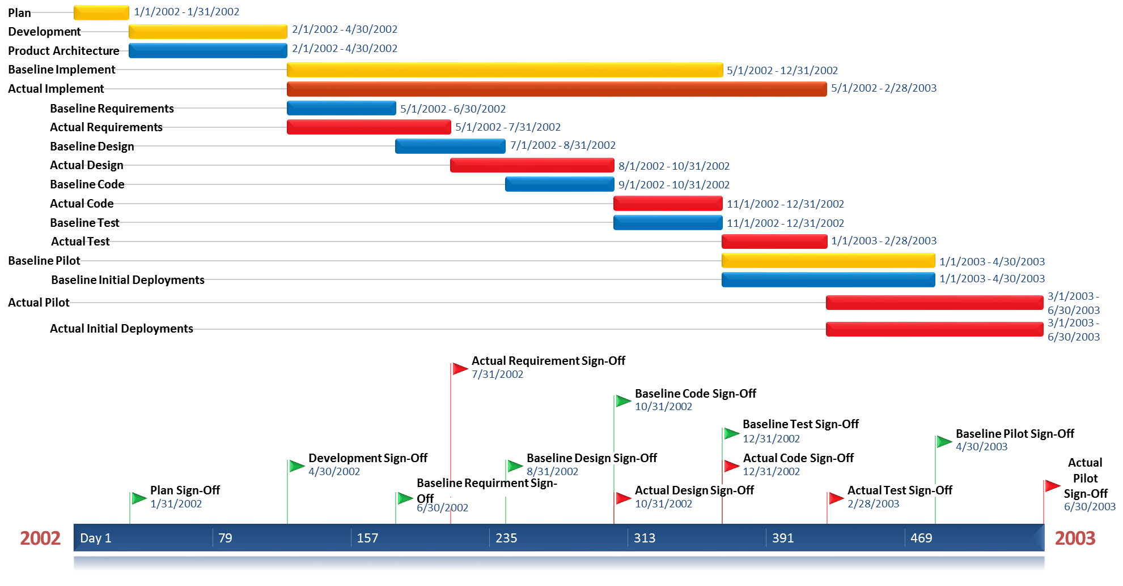
Baseline vs Actual Progress

Slide 9
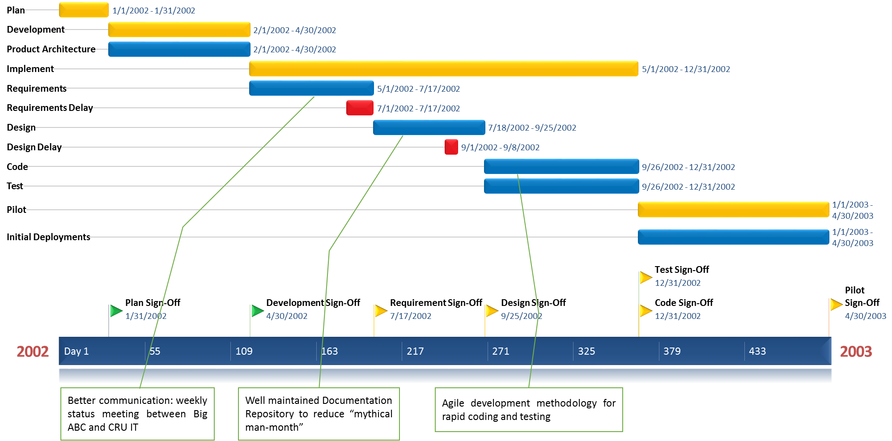
Recommended Timeline

Slide 10
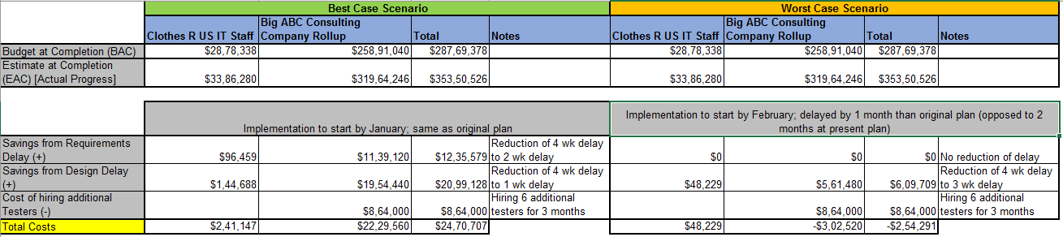
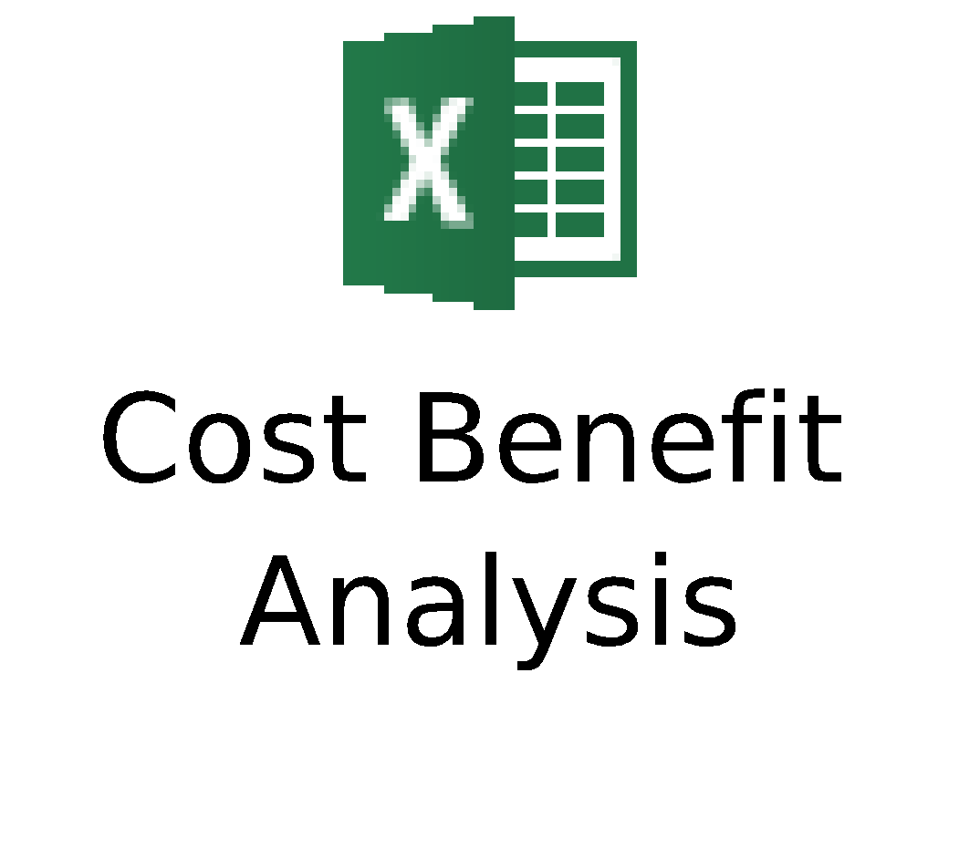
Cost Benefit Analysis

Slide 11
Thank You

Slide 12
References
https://www.villanovau.com/resources/project-management/pmbok-monitoring-controlling-process-group/#.WL4ciDvys2w
https://www.mindtools.com/pages/article/newTMC_07.htm
http://rmcapability.com/7.html
http://www.sciencedirect.com/science/article/pii/S1877042816308655
http://www.sciencedirect.com/science/article/pii/S1090023316301952
http://www.costmanagement.eu/blog-article/198-cost-management-explained-in-4-steps
http://whatis.techtarget.com/definition/cost-management

